Slide 1
Pipelined Processor Design

Slide 2
Pipelining Example
Laundry Example: Three Stages
Wash dirty load of clothes
Dry wet clothes
Fold and put clothes into drawers
Each stage takes 30 minutes to complete
Four loads of clothes to wash, dry, and fold
A
B
C
D

Slide 3
Sequential Laundry
6 PM
7
8
9
10
11
12 AM
Time
30
30
30
30
30
30
30
30
30
30
30
30
A
B
C
D
Sequential laundry takes 6 hours for 4 loads
Intuitively, we can use pipelining to speed up laundry

Slide 4
Pipelined Laundry: Start Load ASAP
6 PM
7
8
9 PM
30
30
30
Time
30
30
30
30
30
30
30
30
30
A
Pipelined laundry takes 3 hours for 4 loads
Speedup factor is 2 for 4 loads
Time to wash, dry, and fold one load is still the same (90 minutes)
B
C
D

Slide 5
Serial Execution versus Pipelining
Consider a task that can be divided into k subtasks
The k subtasks are executed on k different stages
Each subtask requires one time unit
The total execution time of the task is k time units
Pipelining is to start a new task before finishing previous
The k stages work in parallel on k different tasks
Tasks enter/leave pipeline at the rate of one task per time unit.
1
2
…
k
1
2
…
k
1
2
…
k
1
2
…
k
1
2
…
k
1
2
…
k
Without Pipelining
One completion every k time units
With Pipelining
One completion every 1 time unit

Slide 6
Pipelining is one way of improving the overall processing performance of a processor.
This architectural approach allows the simultaneous execution of several instructions
The pipeline design technique decomposes a sequential process into several subprocesses, called stages or segments.
A stage performs a particular function and produces an intermediate result.
It consists of an input latch, also called a register or buffer, followed by a processing circuit.

Slide 7
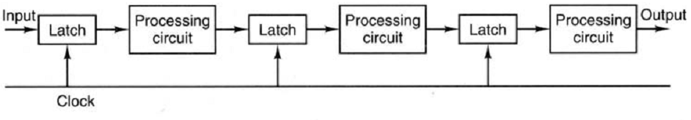
The processing circuit of a given stage is connected to the input latch of the next stage.
A clock signal is connected to each input latch.
At each clock pulse, every stage transfers its intermediate result to the input latch of the next stage.

Slide 8
Synchronous Pipeline
Uses clocked registers between stages
Upon arrival of a clock edge …
All registers hold the results of previous stages simultaneously
It is desirable to have balanced stages
Approximately equal delay in all stages
Input
Register
S₁
Register
S₂
Register
S_{k}
Register
Output
Clock

Slide 9
To be more specific, when n is large, a pipelined processor can produce output approximately k times faster than a nonpipelined processor.

Slide 10
MIPS Instruction Types
Arithmetic & Logical - manipulate data in registers add $s1, $s2, $s3 $s1 = $s2 + $s3 or $s3, $s4, $s5 $s3 = $s4 OR $s5
Data Transfer - move register data to/from memory lw $s1, 100($s2) $s1 = Memory[$s2 + 100] sw $s1, 100($s2) Memory[$s2 + 100] = $s1
Branch - alter program flow beq $s1, $s2, 25 if ($s1==$s1) PC = PC + 4 + 4*25

Slide 11
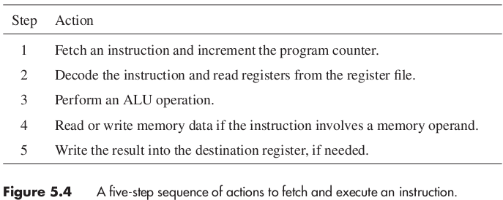
5 Step suitable for all RISC Instructions

Slide 12
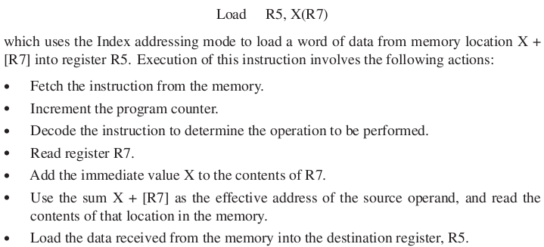

Slide 13
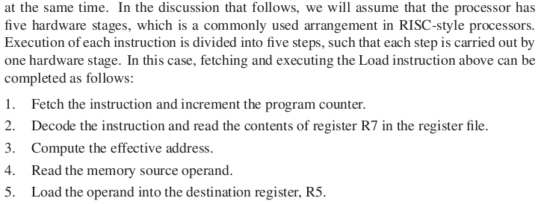

Slide 14
INSTRUCTION PIPELINE
In a von Neumann architecture, the process of executing an instruction involves several steps.
Instruction fetch (IF). Retrieval of instructions from cache (or main memory).
Instruction decoding (ID). Identification of the operation to be performed.
Operand fetch (OF)/. Decoding and retrieval of any required operands.
Execution (EX). Performing the operation on the operands.
Write-back (WB). Updating the destination operands.

Slide 15
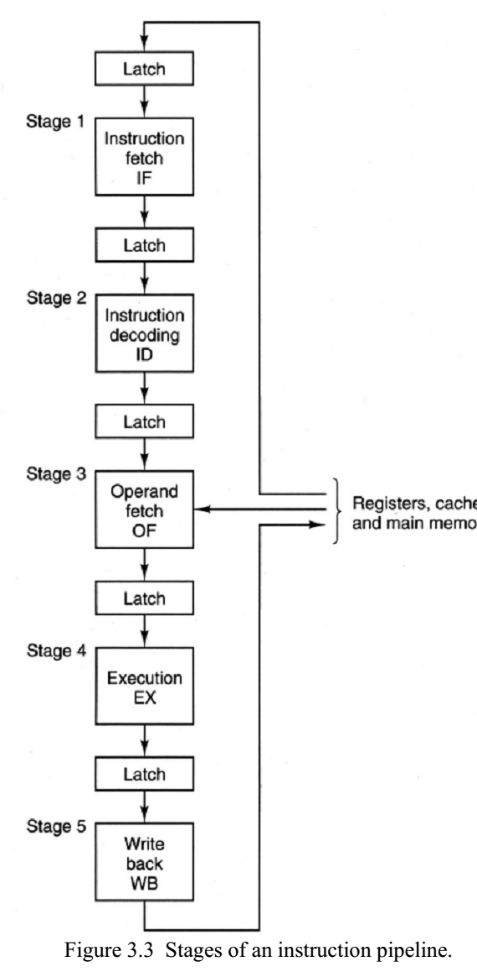
An instruction pipeline increases the performance of a processor by overlapping the processing of several different instructions.
Instruction pipeline overlaps the process of the preceding stages for different instructions to achieve a much lower total completion time, on average, for a series of instructions.

Slide 16
Pipelined Datapath
Pipeline registers, in green, separate each pipeline stage
Pipeline registers are labeled by the stages they separate
IF = Instruction Fetch
ID = Decode
EX = Execute
MEM = Memory
WB
IF/ID
ID/EX
EX/MEM
Inc
Next
PC
Imm26
MEM/WB
00
m
u
x
0
Imm16
zero
Instruction
Memory
Rs
Register
File
ALU result
m
u
x
PC
Address
0
Rt
Ext
A
L
U
Data
Memory
1
Instruction
Address
RW
m
u
x
1
BusW
m
u
x
Data_in
Rd

Slide 17
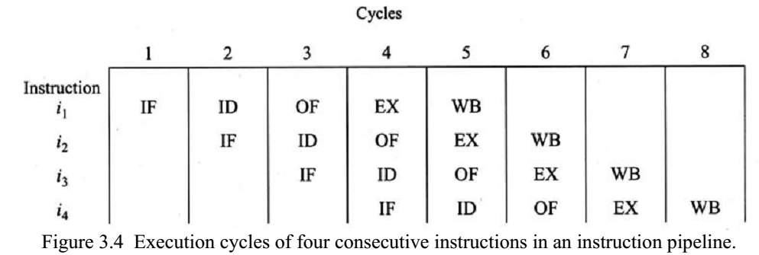

Slide 18
Graphically Representing Pipelines
Figure shows the use of resources at each stage and each cycle
Time (in cycles)
CC1
CC2
CC3
CC4
CC5
CC6
CC7
CC8
lw $6, 8($5)
IM
Reg
ALU
DM
Reg
add $1, $2, $3
IM
Reg
ALU
DM
Reg
Program Execution Order
or $4, $3, 7
IM
Reg
ALU
DM
Reg
sub $5, $2, $3
IM
Reg
ALU
DM
Reg
sw $2, 10($3)
IM
Reg
ALU
DM

Slide 19
Instruction–Time Diagram
Diagram shows:
Which instruction occupies what stage at each clock cycle
Instruction execution is pipelined over the 5 stages
Up to five instructions can be in execution during a single cycle
ALU instructions skip the MEM stage. Store instructions skip the WB stage
lw $7, 8($3)
IF
ID
EX
MEM
WB
lw $6, 8($5)
IF
ID
EX
MEM
WB
Instruction Order
or $4, $3, 7
IF
ID
EX
–
WB
sub $5, $2, $3
IF
ID
EX
–
WB
sw $2, 10($3)
IF
ID
EX
MEM
–
CC1
CC2
CC3
CC4
CC5
CC6
CC7
CC8
CC9
Time

Slide 20
Single-Cycle vs Pipelined Performance
Consider a 5-stage instruction execution in which …
Instruction fetch = ALU operation = Data memory access = 200 ps
Register read = register write = 150 ps
What is the single-cycle non-pipelined time?
What is the pipelined cycle time?
What is the speedup factor for pipelined execution?
Solution
Non-pipelined cycle =
200+150+200+200+150 = 900 ps
IF
Reg
ALU
MEM
Reg
900 ps
IF
Reg
ALU
MEM
Reg
900 ps

Slide 21
Single-Cycle versus Pipelined – cont’d
max(200, 150) = 200 ps
Pipelined cycle time =
CPI for pipelined execution =
One instruction completes each cycle (ignoring pipeline fill)
Speedup of pipelined execution =
Instruction count and CPI are equal in both cases
Speedup factor is less than 5 (number of pipeline stage)
Because the pipeline stages are not balanced
IF
Reg
ALU
MEM
Reg
200
IF
Reg
ALU
MEM
Reg
200
IF
Reg
ALU
MEM
Reg
200
200
200
200
200
1
900 ps / 200 ps = 4.5

Slide 22
The goal of pipelining is to allow multiple instructions execute at the same time.
We may need to perform several operations in a cycle
Increment the PC and add registers at the same time.
Fetch one instruction while another one reads or writes data.
The big benefit from pipelining comes from the fact that once you fed the first element into the pipe (an instruction, for example) the next cycle it's free to accept the next one, long before the previous elements finished the complete datapath.

Slide 23
Pipeline Hazards
Hazards: situations that would cause incorrect execution
If next instruction were launched during its designated clock cycle
Structural hazards
When a resource is not available, Caused by resource contention
Using same resource by two instructions during the same cycle
Data hazards
An instruction may compute a result needed by next instruction
Hardware can detect dependencies between instructions
Control hazards
A control hazard refers to a situation in which an instruction, such as branch, causes a change in the program flow. (branches/jumps)
Delays in changing the flow of control.
Hazards are problems with the instruction pipeline in CPU microarchitectures when the next instruction cannot execute in the following clock cycle

Slide 24
Structural Hazards
Problem
Attempt to use the same hardware resource by two different
instructions during the same cycle
Example
Writing back ALU result in stage 4
Conflict with writing load data in stage 5
Structural Hazard
Two instructions are attempting to write the register file during same cycle
lw $6, 8($5)
IF
ID
EX
MEM
WB
or $4, $3, 7
IF
ID
EX
WB
Instructions
sub $5, $2, $3
IF
ID
EX
WB
sw $2, 10($3)
IF
ID
EX
MEM
CC1
CC2
CC3
CC4
CC5
CC6
CC7
CC8
CC9
Time

Slide 25
Resolving Structural Hazards
Serious Hazard:
Hazard cannot be ignored
Solution 1: Delay Access to Resource
Must have mechanism to delay instruction access to resource
Delay all write backs to the register file to stage 5
ALU instructions bypass stage 4 (memory) without doing anything
Solution 2: Add more hardware resources (more costly)
Add more hardware to eliminate the structural hazard
Redesign the register file to have two write ports
First write port can be used to write back ALU results in stage 4
Second write port can be used to write back load data in stage 5

Slide 26

Data Hazards
There are three primary types of data hazards: RAW (read after write), WAR (write after read), and WAW (write after write).
RAW: This type of data hazard was discussed previously; it refers to the situation in which i2 reads a data source before i1 writes to it.
IF | ID | OF | WB
 | IF | ID | - | OF | WB

Slide 27
OR R1, R7, R9
SW R1, M[090]
AND R2, R7, R10
SUB R11, R2, R12
I1 | IF | ID | OF | WB
I2 |  | IF | ID | - | OF | WB
I3 |  |  | IF | ID | - | OF | MEM | WB
I4 |  |  |  | IF | ID | - | - | - | OF

Slide 28
LW R12, M[9000]
ADD R11,R2,R1
SW R12, M[7000]
SUB R2, R11, R1
IF | ID | OF | MEM | WB
 | IF | ID | OF | - | WB
 |  | IF | ID | - | OF | MEM | WB
 |  |  | IF | ID | - | OF | - | WB

Slide 29
Data Hazards
WAR: This refers to the situation in which i2 writes to a location before i1 reads it.
an invalid result may be produced if i2 writes to R4 before i1 reads it; that is, the instruction i1 might use the wrong value of R4.
WAR cannot occur in our basic 5-stage pipeline because:
Reads are always in stage 2, and
Writes are always in stage 5
Instructions are processed in order

Slide 30
Data Hazards
WAW: This refers to the situation in which i2 writes to a location before i1 writes to it.
the value of R2 is recomputed by i2.
WAW can’t happen in our basic 5-stage pipeline because:
All writes are ordered and always take place in stage 5
WAR and WAW hazards can occur in complex pipelines
Notice that Read After Read – RAR is NOT a hazard.

Slide 31
Solution for Data Hazards
Reordering
Stalling
Forwarding
Connect New Value directly to next stage.

Slide 32
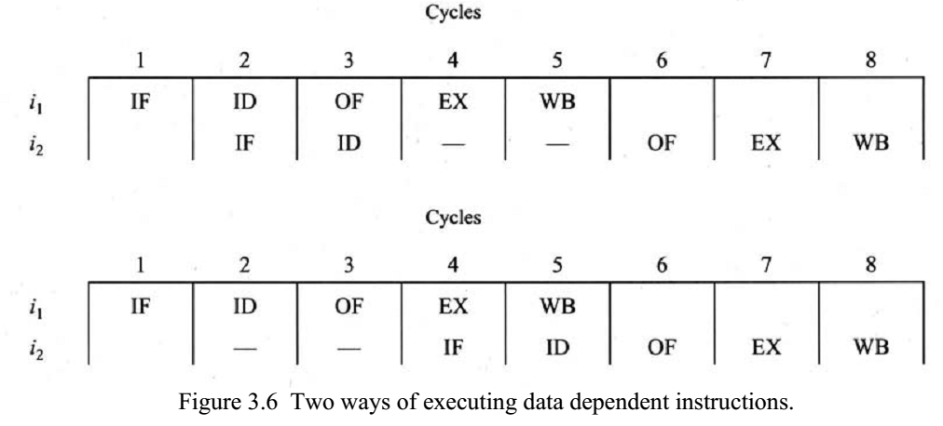
Solution1: Stalling
Instruction i2 is said to be stalled for two clock cycles. NoP(Bubbles are inserted)
Often, when an instruction is stalled, the instructions that are positioned after the stalled instruction will also be stalled. However, the instructions before the stalled instruction can continue execution.
To insert a delay, an extra hardware component called a pipeline interlock can be added to the pipeline. A pipeline interlock detects the dependency and delays the dependent instructions until the conflict is resolved

Slide 33
Data Hazard Solution: Stalling

Slide 34
Stall the Pipeline for one Cycle
Freeze the PC and the IF/ID registers
No new instruction is fetched and instruction after load is stalled
Allow the Load instruction in ID/EX register to proceed
Introduce a bubble into the ID/EX register
Load can forward data to next instruction after delaying it
Time (cycles)
CC1
CC2
CC3
CC4
CC5
CC6
CC7
CC8
lw $2, 20($1)
IM
Reg
ALU
DM
Reg
Program Order
and $4, $2, $5
IM
bubble
Reg
ALU
DM
Reg
or $6, $3, $2
IM
Reg
ALU
DM
Reg

Slide 35
Data Hazard Solution: Rescheduling
Consider the following statements:
a = b + c; d = e – f;
Slow code:
lw $10, ($1) # $1 = addr b
lw $11, ($2) # $2 = addr c
add $12, $10, $11 # stall
sw $12, ($3) # $3 = addr a
lw $13, ($4) # $4 = addr e
lw $14, ($5) # $5 = addr f
sub $15, $13, $14 # stall
sw $15, ($6) # $6 = addr d
Fast code: No Stalls
lw $10, 0($1)
lw $11, 0($2)
lw $13, 0($4)
lw $14, 0($5)
add $12, $10, $11
sw $12, 0($3)
sub $15, $13, $14
sw $14, 0($6)

Slide 36
In today's architectures, the dependencies between instructions are checked statically by the compiler and/or dynamically by the hardware at run time.
This preserves the execution order for dependent instructions, which ensures valid results.

Slide 37
Instruction 0: Register 1 = 6
Instruction 1: Register 1 = 3
Instruction 2: Register 2 = Register 1 + 7 = 10
Following execution, register 2 should contain the value 10. However, if Instruction 1 (write 3 to register 1) does not fully exit the pipeline before Instruction 2 starts executing, it means that Register 1 does not contain the value 3 when Instruction 2 performs its addition
In such an event, Instruction 2 adds 7 to the old value of register 1 (6), and so register 2 contains 13 instead, i.e.:
Instruction 0: Register 1 = 6
Instruction 2: Register 2 = Register 1 + 7 = 13
Instruction 1: Register 1 = 3
Forwarding helps correct such errors by depending on the fact that the output of Instruction 1 (which is 3) can be used by subsequent instructions it is stored in Register 1
https://en.wikipedia.org/wiki/Hazard_(computer_architecture)#Operand_forwarding

Slide 38
Data Hazard Solution: Forwarding
Forwarding applied to the example means that there is no wait to commit/store the output of Instruction 1 in Register 1 (in this example, the output is 3) before making that output available to the subsequent instruction (in this case, Instruction 2).
The effect is that Instruction 2 uses the correct (the more recent) value of Register 1: the commit/store was made immediately and not pipelined.
Forwarding is another solution to data hazard (dependency) with no bubbles/stalls.
https://en.wikipedia.org/wiki/Hazard_(computer_architecture)#Operand_forwarding

Slide 39
Key idea: connect new value directly to next stage
Still read s0, but ignore in favor of new result

Slide 40
Data Hazards - Forwarding
STALL still required for load - data avail. after MEM
MIPS architecture calls this delayed load, initial implementations required compiler to deal with this

Slide 41
Key idea: connect data internally before it's stored
Assumption:
The register file forwards values that are read and written during the same cycle.

Slide 42
Load Delay
Unfortunately, not all data hazards can be forwarded
Load has a delay that cannot be eliminated by forwarding
In the example shown below …
The LW instruction does not have data until end of CC4
AND instruction wants data at beginning of CC4 - NOT possible
Time (cycles)
CC1
CC2
CC3
CC4
CC5
CC6
CC7
CC8
lw $2, 20($1)
IF
Reg
DM
Reg
However, load can forward data to second next instruction
ALU
Program Order
and $4, $2, $5
IF
Reg
ALU
DM
Reg
or $6, $3, $2
IF
Reg
ALU
DM
Reg
add $7, $2, $2
IF
Reg
ALU
DM
Reg

